Slide 1
CLIMATE EMERGENCY
TODAY’S SPEAKERS
The meeting will be chaired by Cllr. Rosa Bolger, Leader of Witney Town Council
Rachael Treharne, Oxford Talks team Extinction Rebellion
Fiona Tavner, Coordinator of Oxford Friends of the Earth
Cllr. Tom Hayes, Labour & Co-operative Cabinet Member for Zero Carbon, Oxford City Council
Lucy Kelahar, Witney Youth Council
Cllr. Andrew Coles, Labour & Co-operative Environmental Lead on West Oxfordshire District Council
Cllr. Dr. Suzanne Bartington, Conservative Independent Alliance (Conservative Party Member) Air Quality & Health Oxfordshire County Council
Chris Church, Sustainable and community development advisor, Friends of the Earth
Question and Answer Session

Slide 2
What is already being done? What else needs to happen? What can WE do? Information, organisations and useful links

Slide 3
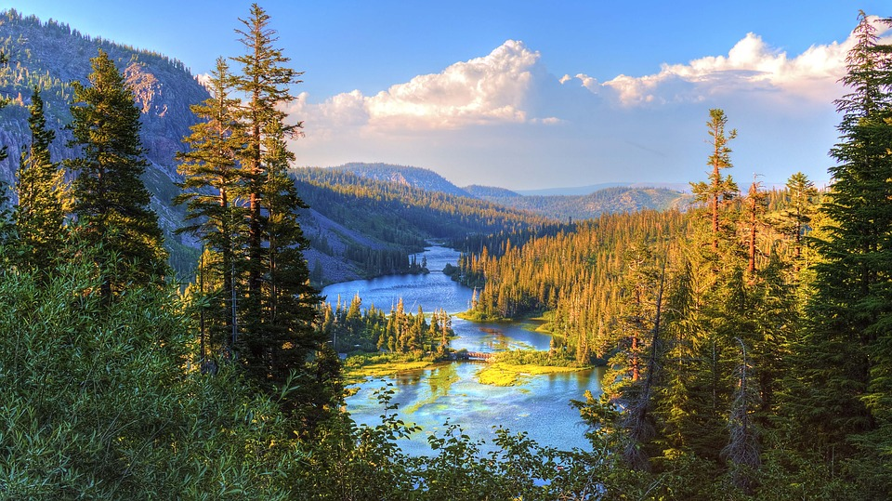
In short, we need to respond to the climate crisis with a proportionate sense of urgency.
It is time to start having a ‘will do’ attitude and doing things; big things, little things, lots of things, everyone. In the street, in the board rooms, in the shops, in the town hall, in the community, at home, in the garden. Everywhere!

Slide 4
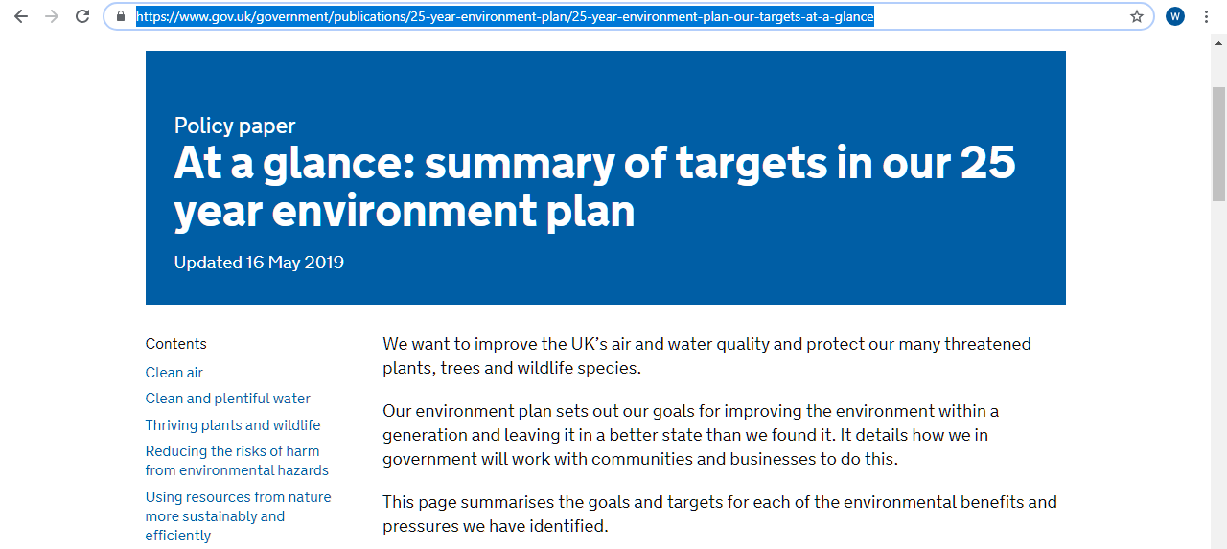
Government Plans
https://www.gov.uk/government/publications/25-year-environment-plan/25-year-environment-plan-our-targets-at-a-glance

Slide 5
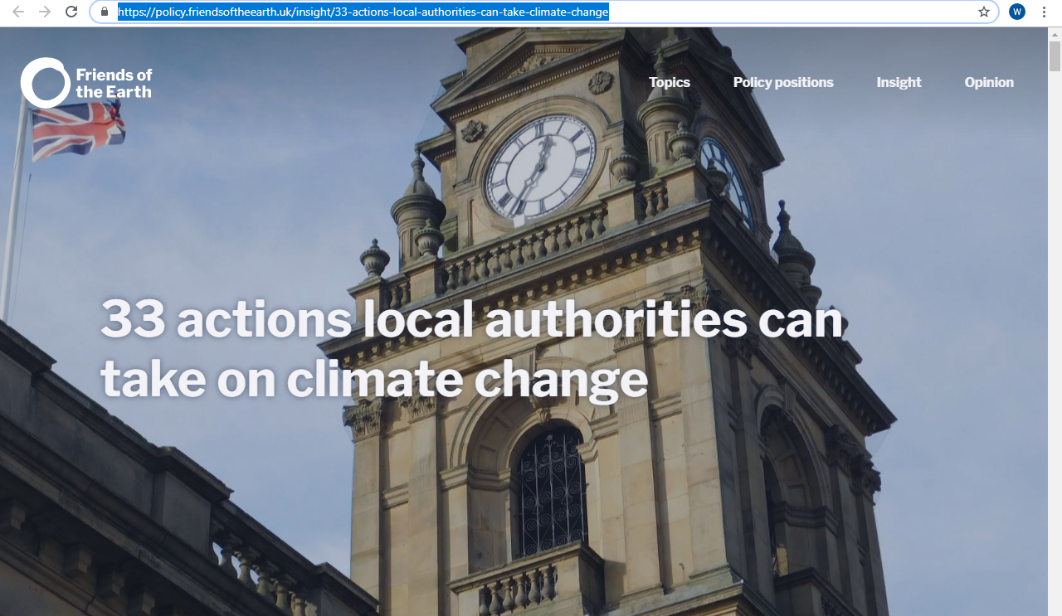
FRIENDS OF THE EARTH
https://policy.friendsoftheearth.uk/insight/33-actions-local-authorities-can-take-climate-change

Slide 6
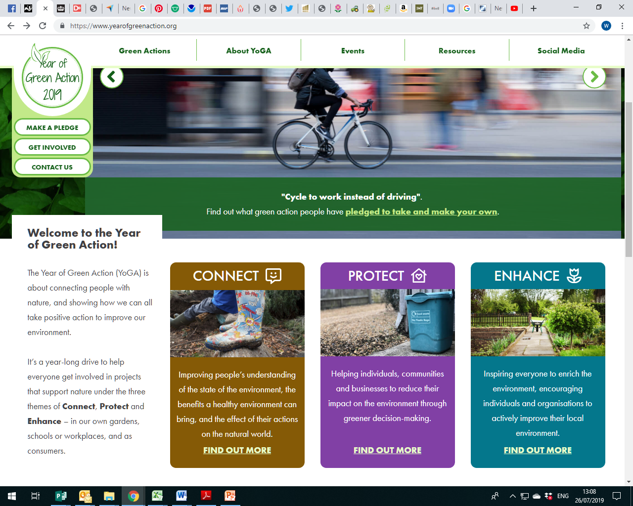
https://www.yearofgreenaction.org/
YEAR OF GREEN ACTION 2019

Slide 7
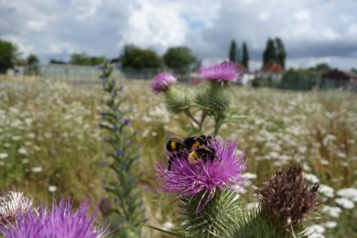
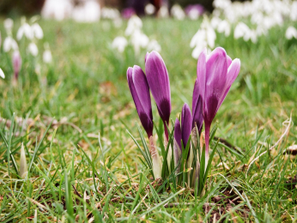
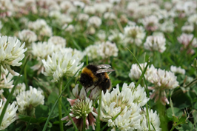
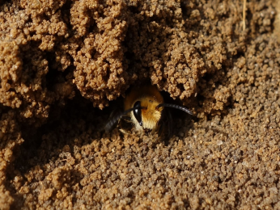
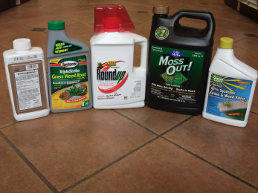
https://www.bumblebeeconservation.org/bees-needs
BUMBLEBEE CONSERVATION
Five Simple Actions for Pollinators
1. Grow more flowers, shrubs & trees
2. Let it grow wild
3. Cut grass less often
4. Don't disturb insect nests and hibernation spots
5. Think carefully about whether to use pesticides
https://www.bumblebeeconservation.org/wp-content/uploads/2018/03/6192_defra_info_sheet_gardens_final.pdf

Slide 8
https://www.wildlifetrusts.org/actions
THE WILDLIFE TRUSTS

Slide 9
https://www.recyclenow.com/recycling-knowledge
RECYCLE NOW

Slide 10
https://www.bigbutterflycount.org/about
BIG BUTTERFLY COUNT
About the big butterfly count
The big butterfly count is a nationwide survey aimed at helping us assess the health of our environment. The big butterfly count 2019 will take place from Friday 19 July - Sunday 11 August.

Slide 11
https://www.oxfordshire.gov.uk/residents/environment-and-planning/countryside/lower-windrush-valley-project/what-we-do#volunteers
LOWER WINDRUSH VALLEY PROJECT
Lower Windrush Valley Project - What we do
Information about us, research, reports and volunteering opportunities.
The Lower Windrush Valley covers 28 square kilometres of West Oxfordshire, incorporating the floodplain of the River Windrush from Witney to where it joins the River Thames at Newbridge.
Over the last 60 years the landscape character of the valley has been transformed by mineral extraction with large areas of the riverside pasture transformed into a mosaic of open water.
With mineral extraction set to continue for many years to come the Lower Windrush Valley Project (LWVP) was created by Oxfordshire County Council to create and implement an environmental strategy for this area.

Slide 12
Saving The Planet – 9 Ways You Can Go Plastic-Free With Your Kids
https://www.kinbox.com/plastic-free/

Slide 13
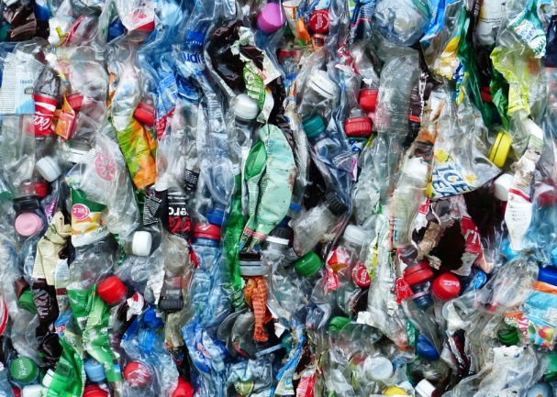
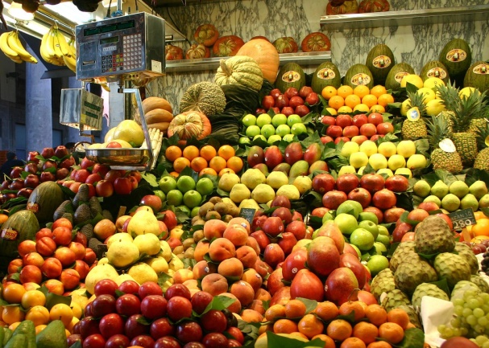
1 Start with education
Talk to your children about recycling. Get them to help you sort out the household waste – this is a good way to show them how much plastic we throw away on a daily basis. Take it to your local recycling facility together or put it out for your local kerbside collection scheme.
2 Go shopping
Our food and supplies often come swathed in so much needless packaging. Choose to buy loose fruit and vegetables and avoid pre-packaged meat in plastic shrink-wrap. If your local supermarket doesn’t offer this as an option the market is a good place to this. Some grocery stores now sell loose staples such as rice, pasta, cereals, and even washing powder – you just need to take along your own containers. Re-use brown paper bags till they fall apart!

Slide 14
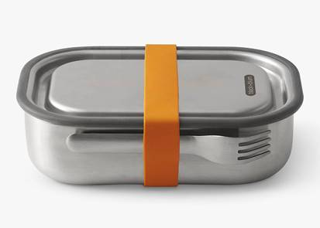
3 Pack an eco-friendly lunch
Think about how many levels of wrapping we are using. A ready-made sandwich in a plastic container. Or wrapped in cling film. Then placed inside a plastic lunch box.
Buy a non-plastic lunchbox or lunch kit. Stainless steel versions are lightweight, sturdy and versatile. Re-useable fabric wraps are great for sandwiches and snacks Re-usable bamboo utensils are great for eating on the go, or better still invest in some cheap, light-weight real cutlery for lunch boxes.
4 Ban the bottle
Instead of plastic water bottles or juice cartons, buy your kids a stainless-steel drinks bottle that can be filled with water or juice every day. Let them design stickers or buy coloured indelible markers so they can decorate and personalise them.

Slide 15
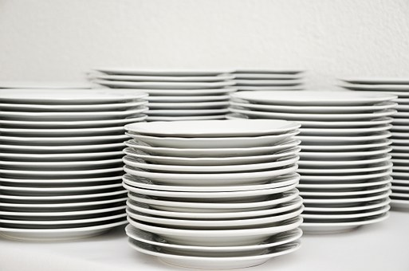
5 Straws suck
If you use plastic straws at home, stop. Switch to paper ones instead. Don’t use plastic straws in cafés and restaurants. If you like, buy your child a colourful reusable straw and keep it handy when you’re out and about.
6 Stick with a cone
Plastic wrappers from ice-lollies, plastic cups with a plastic spoon for ice-cream –contribute to the pollution problem. Choose an edible cone instead.
7 Use real plates
Many parents give their kids plastic plates and utensils at home because they don’t want to risk breakages. We’re not suggesting you serve lunch on your finest bone china, but there’s nothing wrong with teaching your child from an early age how to eat off and treat proper crockery.

Slide 16
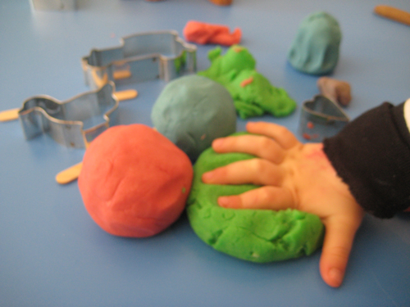
8 Keep it clean
The problem with those plastic handwash dispensers is they’re just so convenient…but it’s time to change. Buy (unwrapped) bars of soap and look for bath bars too – they’re just as creamy and foam just as well as shower gel. You can even buy shampoo versions.
9 Playtime
Kids’ toys tend to involve a lot of plastic and it’s inevitable you’ll have some in your home. Don’t worry – nobody is suggesting you throw them away or refuse future gifts. Building blocks, puzzles and games don’t need to involve plastic. It’s about doing your bit, not depriving your kids. Home made playdough doesn’t come in tubs…

Slide 17
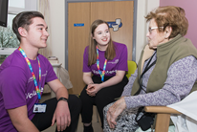
I WILL CAMPAIGN
https://www.iwill.org.uk/about-us/about-iwill-campaign
About the #iwill campaign
Young people aren’t just the leaders of tomorrow. They have the energy, skills and ideas to change society and the environment for the better today. Yet society often fails to listen to young people’s views or recognise their ability to make a positive difference. This is particularly the case for young people from low-income communities.
All young people should be supported and empowered to be active citizens. That’s why the #iwill campaign, supported by over 1,000 organisations from across the UK, aims to make participation in social action – such as volunteering, fundraising, mentoring and campaigning – the norm for young people aged 10 to 20.

Slide 18
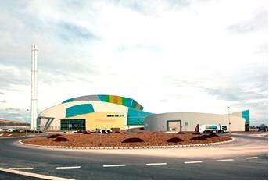
Free tour of Ardley Energy Recovery Facility on August 6th 10am-12pm.
Come along and see where West Oxfordshire’s refuse is processed and visit the state of the art Recycling Visitor Centre showing sustainable waste management and how energy recovery fits into the waste hierarchy. The popular tour will last approximately 1.30hr and limited spaces are available so booking is essential .
To reserve your place please send your full name and contact number to Sian Edwards Sian.Edwards@publicagroup.uk
You can see more details of the facility here: https://www.viridor.co.uk/energy/energy-recovery-facilities/ardley-erf/

Slide 19
LOCAL PROJECTS
There is money available to groups who want to undertake “high impact community-led climate action”
£100million National Lottery Climate Action Fund launched for communities across the UK
More info on the following slide

Slide 20
£100million National Lottery Climate Action Fund launched for communities across the UK
The National Lottery Community Fund has today launched a new £100 million Climate Action Fund that will enable people and communities to take the lead in tackling the climate emergency.
The new fund, from the largest funder of community activity in the UK, will build a network of people and communities, well-placed to drive change within, between and beyond their community.
The funder has said that types of activities will differ from place to place, but will have one thing in common: the ability to deliver high impact community-led climate action. This includes in areas such as sustainable energy, sustainable transport, consumption, food and protecting and regenerating spaces and habitats.
The new fund is being launched as the level of concern over climate change continues to rise, with 80% of the public saying they are very or fairly concerned about climate change⁽¹⁾.
Dawn Austwick, Chief Executive of The National Lottery Community Fund, said: “Everyone can play their part in addressing climate change. The impact will be all the greater if we come together within and across communities. This is why, thanks to National Lottery players, we are launching the Climate Action Fund to create grassroots momentum built on learning and sharing within, between and beyond communities – in order to achieve meaningful and sustained climate action.”
https://www.tnlcommunityfund.org.uk/news/press-releases/2019-07-18/100million-national-lottery-climate-action-fund-launched-for-communities-across-the-uk

Slide 21
THANK YOU!
For coming along and listening and contributing. The slides herewith organisation details will be available with additional information on the Witney Town Council website as soon as possible.

